Slide 1
Let’s Talk About
Eating Disorders
Reclaiming Health, Hope, and Balance

Slide 2
What is an Eating Disorder?
A serious mental health condition characterized by ongoing difficulties with:
  Eating behaviors
  Thoughts & emotions related to food
  Body image & weight
  Emotional well-being
Are coping mechanisms, not character flaws.
Approximately 9% of the US population (28 million) have an eating disorder.

Slide 3
Common Eating Disorders
Anorexia Nervosa – “means not wanting to eat”
Main features:
  Intense fear of weight gain
  Restricting food intake
  Distorted body image
  Strong need for control
  May be underweight, but not always
Common behaviors:
  Skipping meals
  Eating very small portions
  Excessive exercise
  Avoiding “unsafe” foods

Slide 4
Anorexia Nervosa
Main types:
  Restrictive anorexia
    Severely limiting food intake. Some people exercise excessively so they don’t gain weight.
  Binge-purge anorexia
    Limiting food AND episodes of binge eating and/or purging.
Overtime anorexia can lead to:
  Severely low Body Mass Index)
  Malnutrition (starvation) affects nearly every organ and tissue in your body.
    Kidney and liver damage
    Heart failure or cardiac arrest
    Delayed growth in children
    Infertility in adults
    Self- harm and suicidal thoughts

Slide 5
Common Eating Disorders
Bulimia Nervosa
Main features:
  Repeated binge eating (large amounts of food in a short time)
  Followed by behaviors to “undo” the eating (Compensatory behaviors to prevent weight gain), such as:
    Vomiting
    Laxative use
    Fasting
    Excessive exercising
People often may:
  Feel out of control while bingeing
  Feel guilt or strong shame
  Appear normal or fluctuating weight, making it harder to detect

Slide 6
Common Eating Disorders
Binge Eating Disorder (BED)
Main features:
  Recurrent binge eating without purging
  Eating large amounts quickly
  Feeling out of control
Common experiences:
  Eating when not hungry
  Eating alone due to shame
  Feeling guilt or disgust after
Core struggle:
“Food is how I cope.”

Slide 7
Common Eating Disorders
Avoidant/Restrictive Food Intake Disorder (ARFID)
Main features:
  Limited range of foods
  Not driven by body image
  Fear of choking, vomiting, or sensory discomfort
Common reasons:
  Texture sensitivity
  Fear after a bad experience
  Low appetite or lack of interest in food
Core struggle:
“Food feels unsafe.”

Slide 8
What causes eating disorders?
There’s not 1 exact cause or explanation.
Contributing Factors:
  Environment
    Family
    Culture
    Media
    Peers
    Experiences (trauma, grief, mental disorders)
  Genetic component
The way individual manage stress
  Many use food as a coping mechanism that they can “control”

Slide 9
Influences on Eating Behavior
Family Dynamics
    Messages about food, weight, or body image growing up
    Food used as reward, comfort, or punishment
    Family conflict, high expectations, or lack of emotional support
    Eating habits modeled by caregivers
Social & Media
    Unrealistic body standards as “ideal” body images
    Diet culture promoted as health or wellness
    Before/after images and transformation messaging
Peer Pressure
    Comments from friends, coworkers, or partners about weight or food
    Pressure to eat a certain way to fit in
    Fear of judgment around eating in public

Slide 10
Influences on Eating Behavior
  4. Cultural & Religious Factors
    Cultural expectations around body size or eating habits
    Religious fasting practices or food restrictions
    Community norms around celebration, food, and discipline
  5. Health Trends & Wellness Culture
    Diets marketed as “lifestyle changes” or “health plans”
    Fitness or nutrition trends that encourage control or rigidity
    Weight as a measure of health
  6. Emotional & Psychological Factors
    Anxiety, depression, grief, or trauma
    Low self-esteem or body dissatisfaction
    Using food to cope with stress or emotions

Slide 11
Development of Eating Disorders
Distorted Sense of Self
Identity Becomes Tied to Appearance
  When someone has a distorted self-image, their worth gets measured by size, shape, or control over food
  instead of values, abilities, or relationships.
  “I am thin” replaces “I am kind / capable / creative.”
  Success or failure feels like it depends on the scale or the mirror.
  Over time, this shrinks their identity into something very fragile and easily shaken.

Slide 12
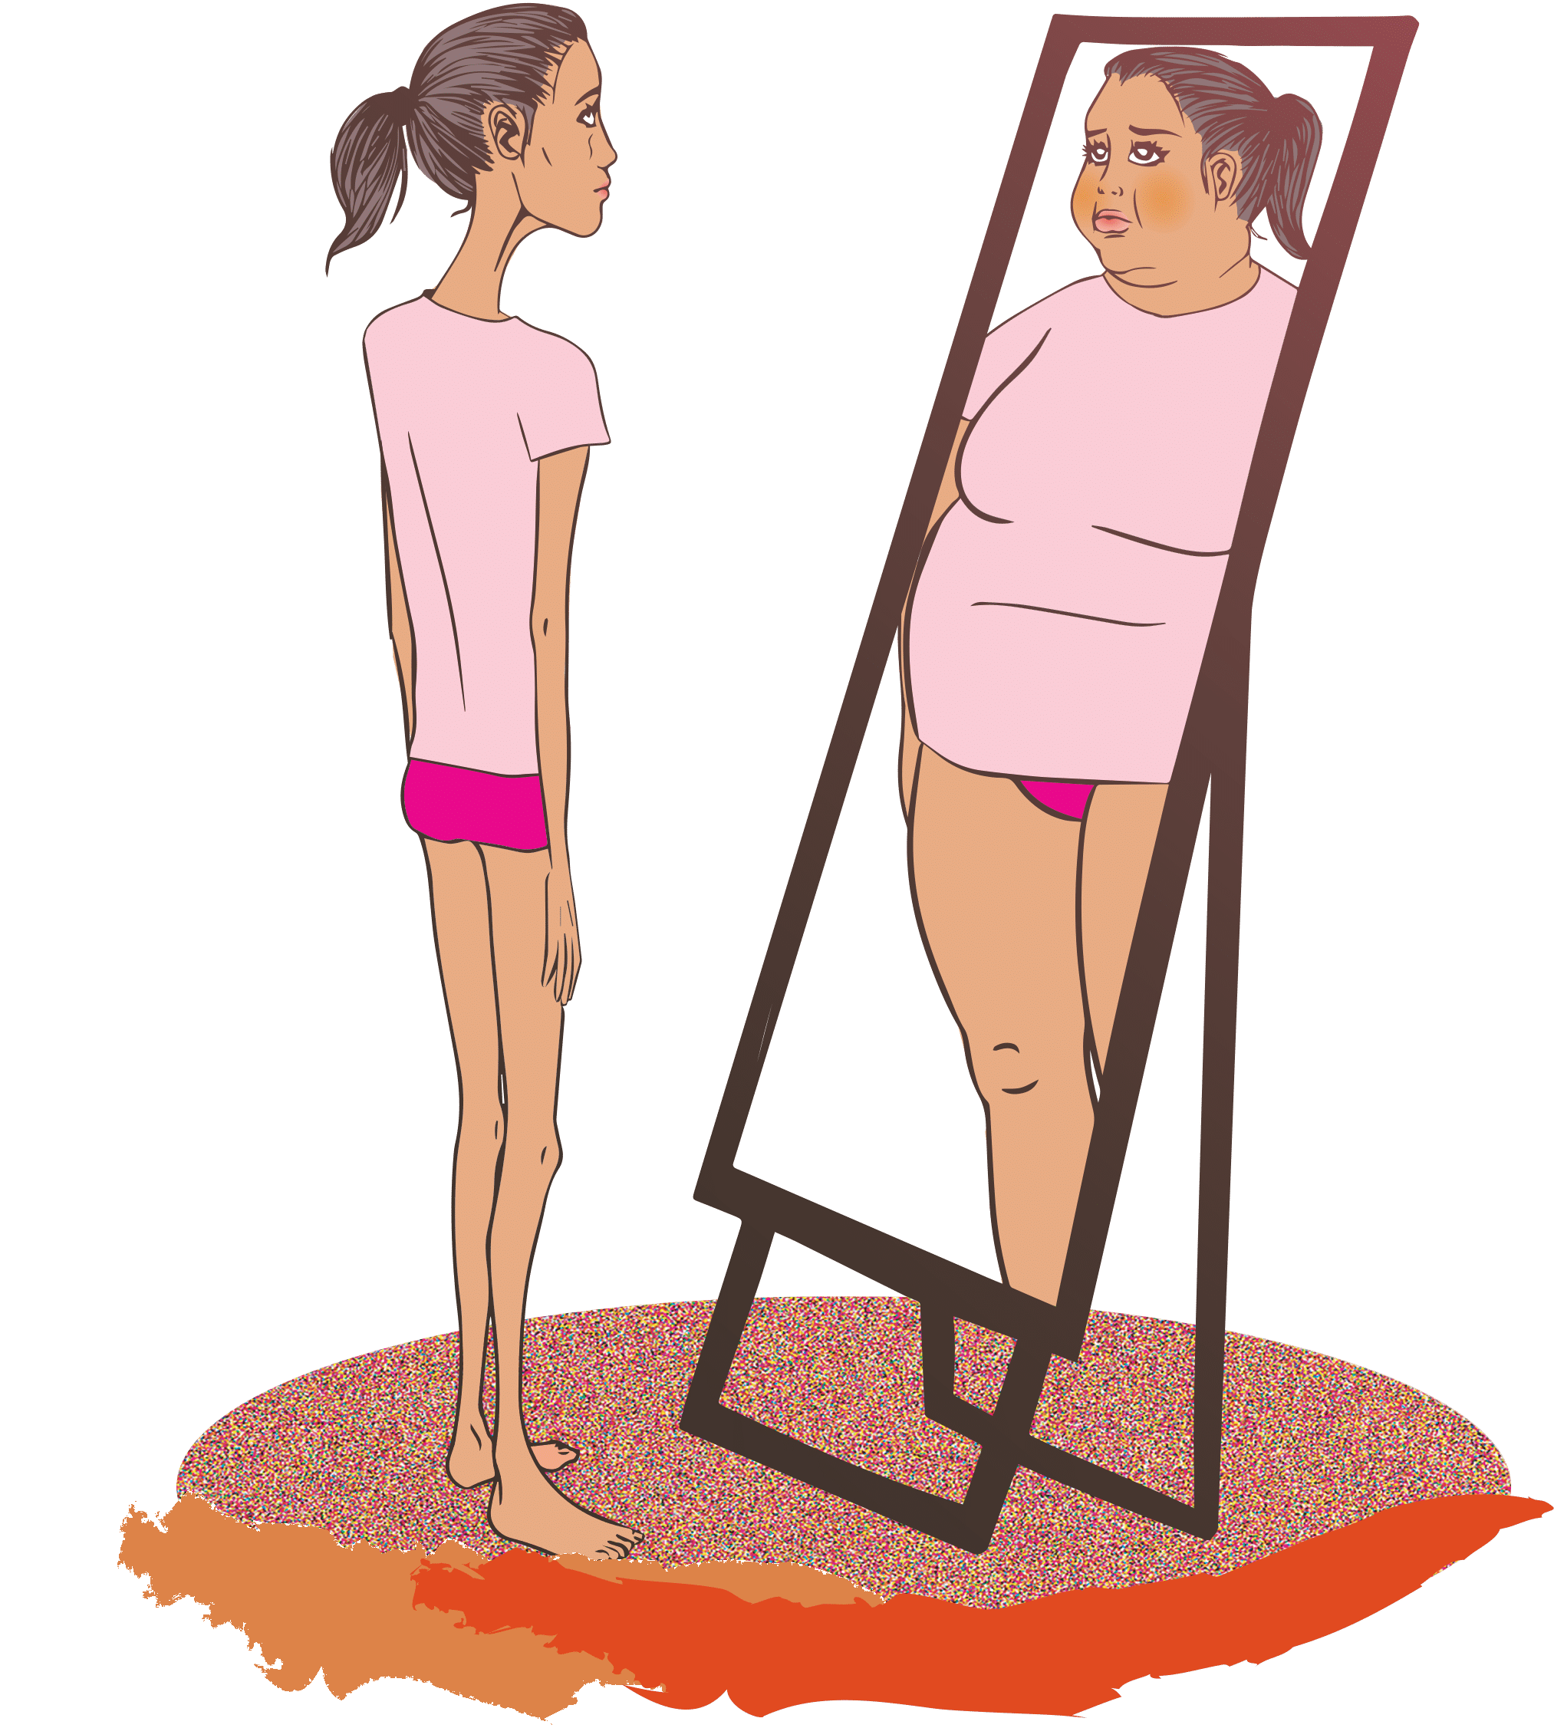
Development of Eating Disorders
Distorted Sense of Self
Body Perception Is Unreliable
Distorted self often means what they see isn’t what others see.
A healthy body can feel “too big.”
Minor changes feel catastrophic.
This creates constant distress and mistrust of their own perception, which fuels restrictive eating, purging, or bingeing to “fix” something that isn’t actually broken.

Slide 13
Development of Eating Disorders
Distorted Sense of Self
Control Replaces Emotional Safety
For many people, eating behaviors become a way to:
  Cope with anxiety or trauma
  Feel powerful when life feels chaotic
  Avoid emotions they don’t know how to handle
So instead of learning “I can handle my feelings,” the belief becomes:
👉 “I can only handle life if I control my body or food.”
That weakens emotional regulation and reinforces a fragile self-concept.

Slide 14
Development of Eating Disorders
Distorted Sense of Self
Cognitive Distortions Take Over
Common thought patterns:
  All-or-nothing thinking (“I ate badly, so I failed.”)
  Harsh self-judgment (“I’m disgusting.”)
  Mind-reading (“Everyone thinks I’m fat.”)
These distortions:
✔ deepen shame
✔ increase isolation
✔ reduce self-compassion
✔ make recovery feel undeserved
The self becomes an enemy instead of something to protect.

Slide 15
Development of Eating Disorders
Distorted Sense of Self
Relationships Suffer
A distorted self and ED can lead to:
  Withdrawal from friends and family
  Avoiding meals or social events
  Comparing bodies constantly
  Feeling “less than” others
This can create:
  Loneliness
  Dependence on the disorder for identity
  Fear of being seen as they truly are
So the disorder becomes a “companion” when connection feels too risky.

Slide 16
Development of Eating Disorders
Distorted Sense of Self
Long-Term Psychological Impact
Over time, this can lead to:
  Chronic low self-esteem
  Anxiety and depression
  Perfectionism and rigidity
  Difficulty trusting one’s own needs
  Fear of adulthood or autonomy
Loss of joy
In short:
  The self becomes organized around fear instead of values.

Slide 17
Distorted Sense of Self: Why it Develops
Trauma
Trauma (abuse, neglect, bullying, violence, medical trauma, or chronic stress) can damage the sense of self by teaching harmful beliefs such as:
  “I am unsafe.”
  “Something is wrong with me.”
  “My body failed me.”
  “I caused what happened.”
Trauma can lead to:
  Shame-based identity
  Disconnection from the body
  Feeling powerless or defective
  Confusion between danger and normal stress
A distorted sense of self doesn’t appear randomly. It usually forms over time as the brain tries to make sense of pain, fear, and expectations.

Slide 18
Distorted Sense of Self: Why it Develops
Anxiety
Anxiety trains the brain to constantly scan for:
  mistakes
  rejection
  threats
  “not good enough” signs
Over time, this can create:
  Hyper-self-monitoring
  Fear of being judged
  Rigid self-rules (“I must be perfect”)
  Identity built on performance and control
The anxious self becomes:
👉 “I am only okay if nothing goes wrong.”
A distorted sense of self doesn’t appear randomly. It usually forms over time as the brain tries to make sense of pain, fear, and expectations.

Slide 19
Distorted Sense of Self: Why it Develops
Depression
Depression distorts self-image by changing how the brain processes information:
  It filters out positives
  Magnifies failures
  Interprets neutral events as personal flaws
Depression teaches beliefs like:
  “I am a burden.”
  “I am broken.”
  “Nothing about me is good.”
Over time, the self becomes defined by:
  hopelessness
  worthlessness
  shame
A distorted sense of self doesn’t appear randomly. It usually forms over time as the brain tries to make sense of pain, fear, and expectations.

Slide 20
Distorted Sense of Self: Why it Develops
Body Image Pressure (Social & Cultural)
Cultural messages (media, peers, family, social media) often teach:
  Thin = worthy
  Fit = disciplined
  Attractive = lovable
  Aging or weight gain = failure
This can lead to:
  Comparing constantly
  Reducing identity to appearance
  Believing love must be earned through looks
Instead of “I am a person,” the message becomes:
👉 “I am a body to be evaluated.”
This is especially powerful during:
  adolescence
  trauma recovery
  periods of low self-esteem
A distorted sense of self doesn’t appear randomly. It usually forms over time as the brain tries to make sense of pain, fear, and expectations.

Slide 21
How These Factors Interact
These contributors rarely exist alone:
  Trauma can lead to anxiety and depression.
  Anxiety can increase body control behaviors.
  Depression can make body image more negative.
  Body pressure can worsen trauma-based shame.
Together they can form this belief:
  “If I fix my body or control myself perfectly, I will finally be okay.”
  This turns the self into a project instead of a person.

Slide 22
Recovery Implication
Healing requires more than normalizing eating. It means:
  Rebuilding identity beyond appearance
  Learning to tolerate emotions
  Developing self-compassion
  Separating “who I am” from “what I weigh”
  Relearning trust in one’s body and internal cues
Recovery is often about moving from:
❌ “My body is the problem.”
to
✅ “My pain deserves care, not punishment.”

Slide 23
Signs and Warning Signals
Physical Warning Signs
Weight loss or gain (or frequent fluctuations)
Dizziness or fainting
Fatigue or weakness
Cold intolerance
Hair thinning or hair loss
Dry skin or brittle nails
Stomach pain or bloating
Constipation
Menstrual changes or loss of period
Swollen cheeks or jaw (from vomiting)
Sore throat
Dental problems
Trouble concentrating
Social & Lifestyle Changes
Withdrawal from friends or family
Avoiding social events with food
Increased isolation
Loss of interest in activities
Increased secrecy
Changes in sleep
Drop in school or work performance

Slide 24
Signs and Warning Signals
Behavioral Signs
Skipping meals or eating very small portions
Avoiding eating in front of others
Rigid food rules (only certain foods, certain times)
Frequent dieting or “starting over”
Cutting out food groups
Hiding or hoarding food
Going to the bathroom right after meals
Excessive or compulsive exercise
Weighing self often or body checking
Wearing baggy clothes to hide body
Sudden interest in cooking but not eating
Lying about eating or weight
Emotional & Psychological Signs
Strong fear of weight gain
Obsession with food, calories, or body
Feeling “out of control” around food
Guilt or shame after eating
Perfectionism
Low self-esteem
Mood swings
Anxiety around meals
Depression or hopelessness
Irritability
Feeling “never good enough”

Slide 25
Treatment & Recovery
Eating disorders are treatable.
Recovery is possible.
Treatment focuses on both the behaviors and the emotional reasons behind them.
Treatment is comprehensive:
  Medical care
  Nutrition
  Therapy approaches

Slide 26
Treatment & Recovery
Medical Stabilization
Medical care is often the first step because malnutrition and purging can impact:
  heart rhythm
  blood pressure
  electrolytes
  digestion
  hormones
  bone health
  cognition
Doctors monitor:
  vital signs
  lab work
  weight trends
  dehydration
  fainting or weakness
Goal:
  Restore a healthy weight
  Create physical safety so psychological work can be effective.

Slide 27
Treatment & Recovery
Nutrition Rehabilitation
Dietitians focus on:
✔ restoring consistent eating (meals + snacks)
✔ rebuilding hunger and fullness cues
✔ reducing food fear
✔ eliminating restrictive food rules
✔ normalizing portions
✔ preventing binge-restrict cycles
Nutrition therapy includes:
  meal plans (temporary structure, not permanent rules)
  food exposure
  grocery and restaurant support
  education about metabolism and starvation effects
  gentle reintroduction of feared foods
Core message:
Food is medicine. Eating regularly helps calm the brain.

Slide 28
Treatment & Recovery
Psychotherapy
Addresses:
  The thoughts, emotions, behaviors, and relationships affected by the disorder.
  Therapy is collaborative and trauma-informed, emphasizing choice, safety, and empowerment.
  Progress is measured by increased food tolerance, improved emotional coping, and a stronger, healthier sense of self, rather than perfection.
Key goals include:
  Reducing harmful behaviors (bingeing, purging, restriction, or avoidance)
  Identifying and challenging distorted beliefs about food, body, and self-worth
  Teaching coping skills for difficult emotions, anxiety, or trauma triggers
  Rebuilding self-esteem, self-compassion, and emotional regulation
  Supporting trauma processing when relevant, ensuring safety
  Improving social connections and relationships

Slide 29
Closing
Eating disorders thrive in silence, but healing happens in connection.
You are NOT broken, you are NOT weak, and you are NOT alone!
If you or someone you love needs help, seek help.
  National Alliance for Eating Disorders
    1-866-662-1235
  Crisis Lifeline
    Call or text 988
    Text HOME TO 741741
  Miccosukee Clinic
    Referrals and in-house assistance

